Slide 1
CS2040S Tutorial 11

Slide 2
Administrative Matters
Attendance taking
PS7-8 Feedback if any

Slide 3
Today’s tutorial
Quick Content recap (MST)
Tutorial questions
MST
Dynamic Programming

Slide 4
MST

Slide 5
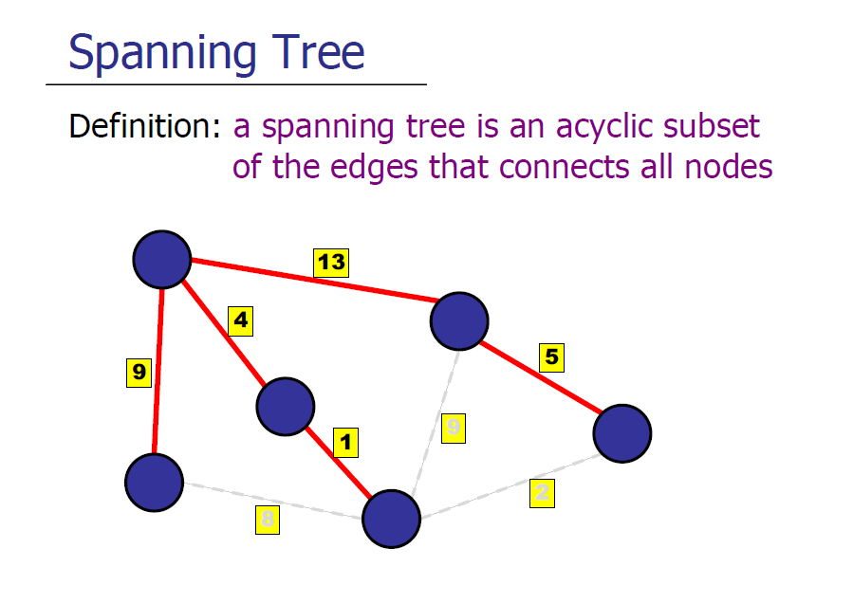

Slide 6
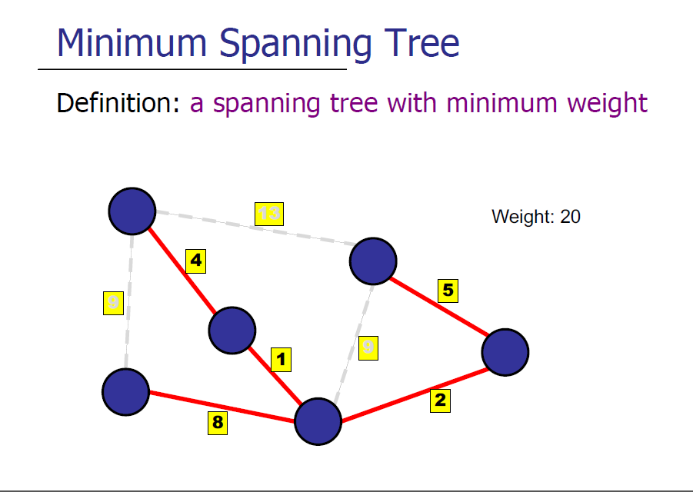

Slide 7
Can we use MST to find Shortest Paths?

Slide 8
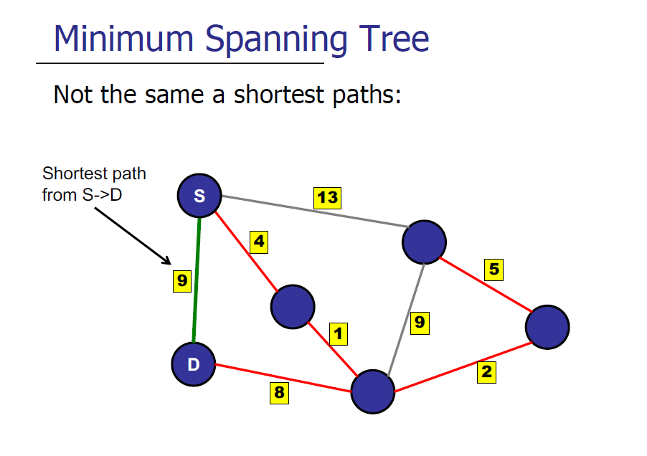
!!!!!

Slide 9
Properties of MST

Slide 10
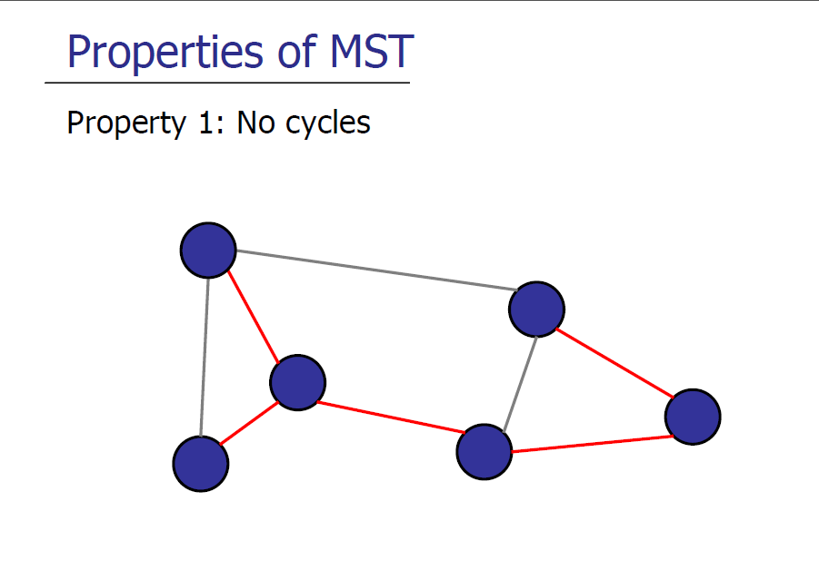

Slide 11
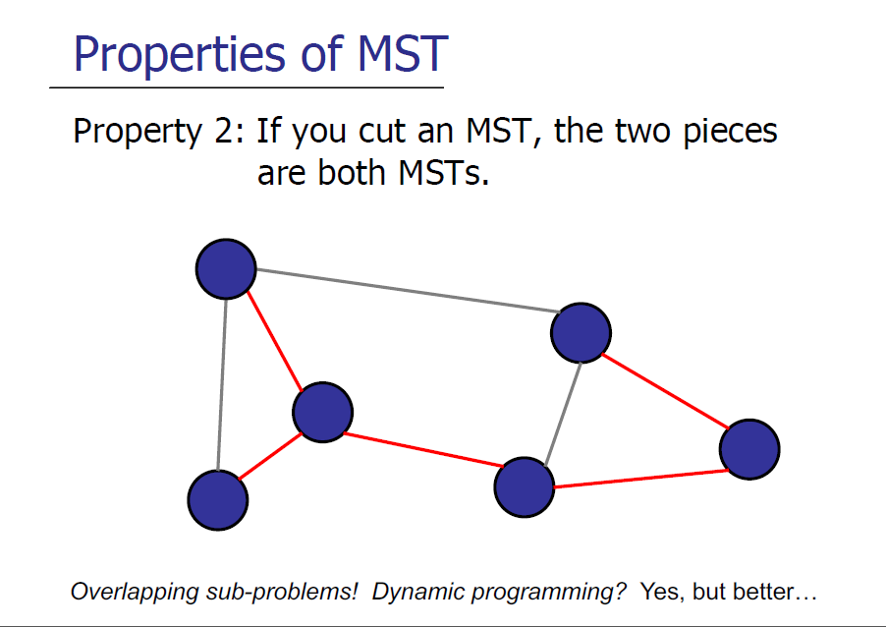

Slide 12
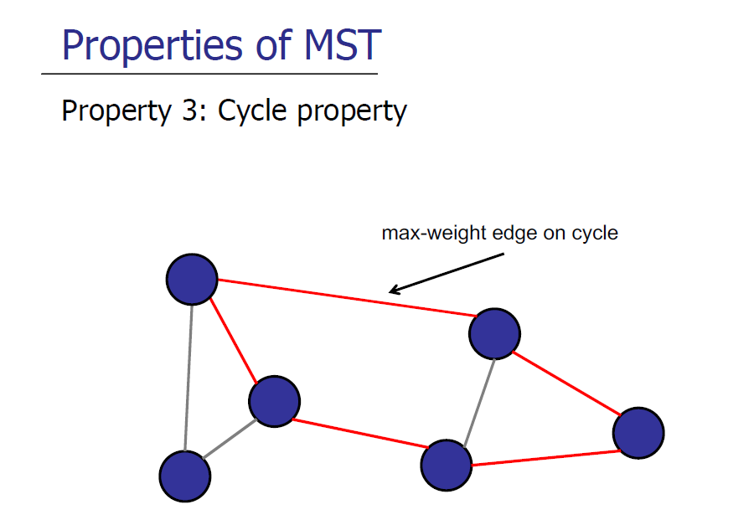
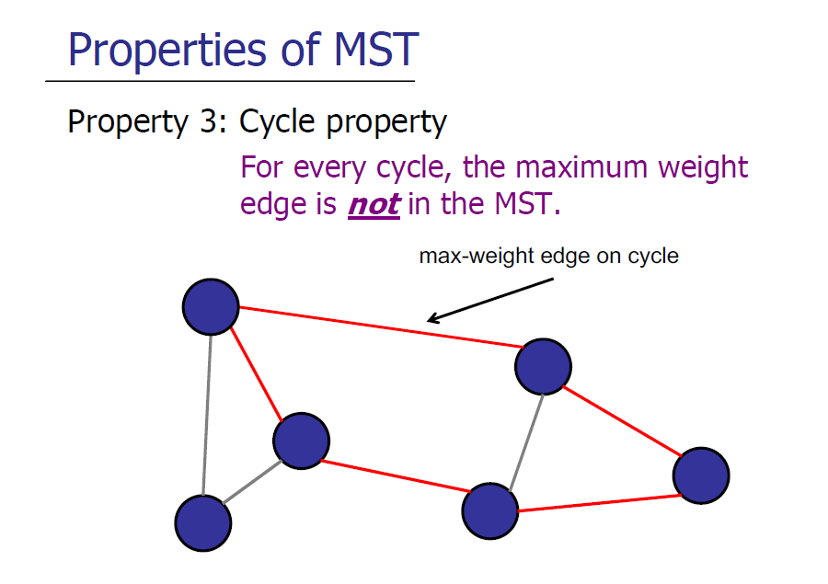

Slide 13
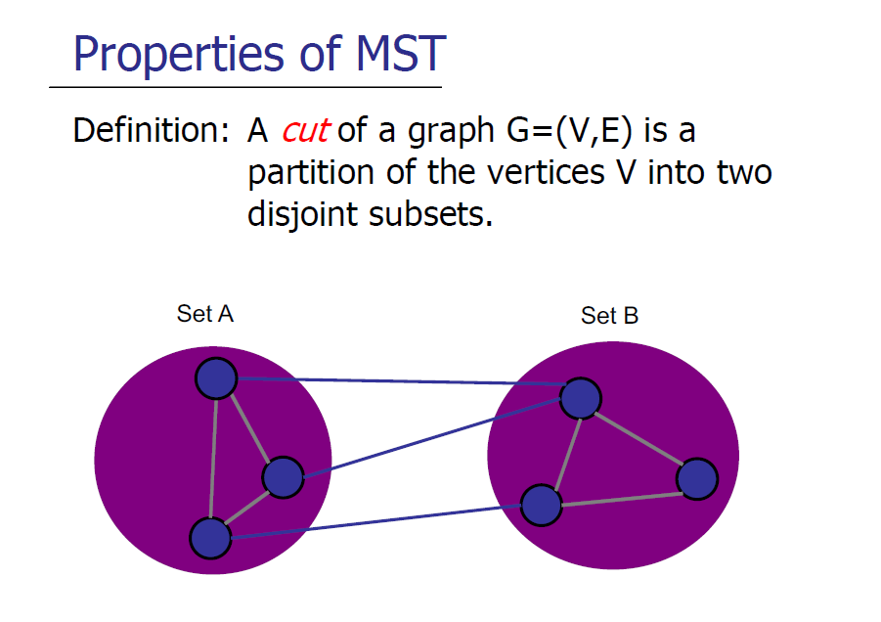

Slide 14
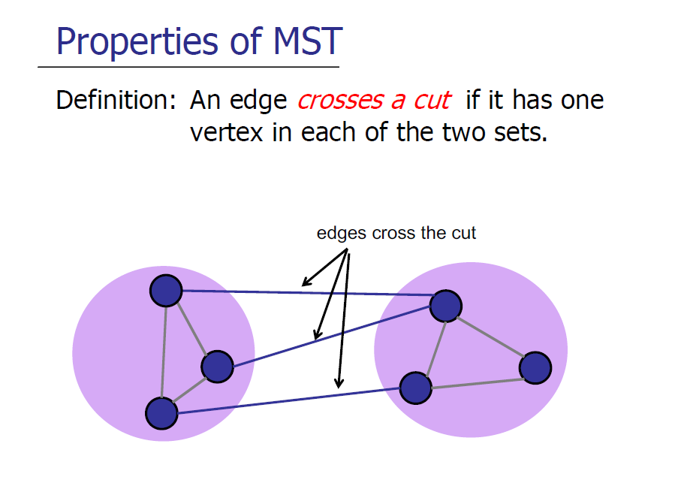

Slide 15
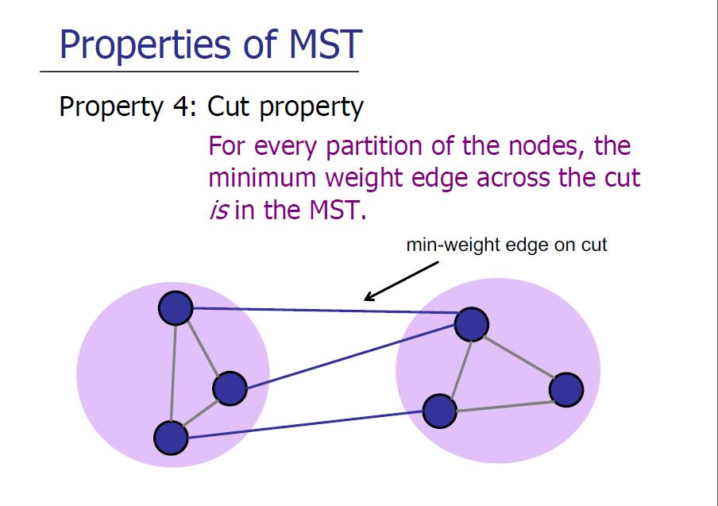

Slide 16
Tutorial Qns

Slide 17
MST Algorithms (Problem 1)

Slide 18
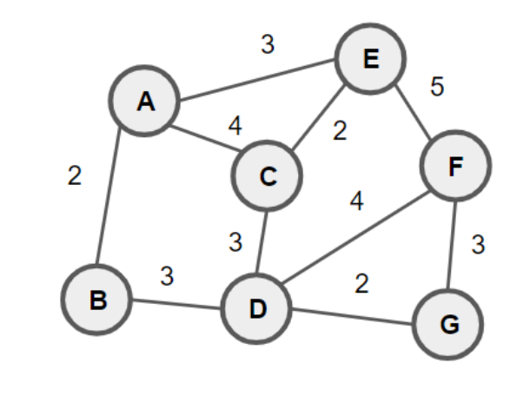
Q1: Determine the edges in the MST
Prim’s (add one vertex at a time, expanding the connected component)
Kruskal’s (add one edge at a time, avoiding cycles)

Slide 19
Prim’s Algorithm

Slide 20
Prim’s Algorithm
Credits to Matthew for this diagram
Basic Idea: “Keep growing one connected component”
3
E
A
5
4
2
2
C
F
4
3
3
3
2
B
D
G

Slide 21
Prim’s Algorithm
Credits to Matthew for this diagram
Basic Idea: “Keep growing one connected component”
Start from a source
3
E
A
5
4
2
2
C
F
4
3
3
3
2
B
D
G

Slide 22
Prim’s Algorithm
Modified from Matthew’s diagram
Basic Idea: “Keep growing one connected component”
Start from a source
Identify cut between this connected component and everything else
3
E
A
5
4
2
2
C
F
4
3
3
3
2
B
D
G

Slide 23
Prim’s Algorithm
Modified from Matthew’s diagram
Basic Idea: “Keep growing one connected component”
Start from a source
Identify cut between this connected component and everything else
Pick the lightest edge
3
E
A
5
4
2
2
C
F
4
3
3
3
2
B
D
G

Slide 24
Prim’s Algorithm
Modified from Matthew’s diagram
Recall: The lightest edge across the cut is always in the MST
Basic Idea: “Keep growing one connected component”
Start from a source
Identify cut between this connected component and everything else
Pick the lightest edge
3
E
A
5
4
2
2
C
F
4
3
3
3
2
B
D
G

Slide 25
Prim’s Algorithm
Modified from Matthew’s diagram
Basic Idea: “Keep growing one connected component”
Start from a source
Identify cut between this connected component and everything else
Pick the lightest edge
Now that node is part of our connected component that we are growing!
3
E
A
5
4
2
2
C
F
4
3
3
3
2
B
D
G

Slide 26
Prim’s Algorithm
Modified from Matthew’s diagram
Basic Idea: “Keep growing one connected component”
Start from a source
Identify cut between this connected component and everything else
Pick the lightest edge
Now that node is part of our connected component that we are growing!
Repeat until all nodes have been visited!
3
E
A
5
4
2
2
C
F
4
3
3
3
2
B
D
G

Slide 27
3
E
A
5
4
2
2
C
F
4
3
3
3
2
B
D
G

Slide 28
3
E
3
E
A
5
5
4
A
2
4
2
2
C
F
F
4
2
C
4
3
3
3
3
3
2
3
2
B
D
B
G
D
G

Slide 29
3
E
3
3
E
E
A
5
5
A
5
4
A
4
2
4
2
2
2
C
F
F
2
C
F
4
2
C
4
4
3
3
3
3
3
3
3
2
3
2
3
2
B
D
B
B
D
G
D
G
G

Slide 30
3
E
3
3
E
E
A
5
5
A
5
4
A
4
2
4
2
2
2
C
F
F
2
C
F
4
2
C
4
4
3
3
3
3
3
3
3
2
3
2
3
2
B
D
B
B
D
G
D
G
G
3
E
A
5
4
2
2
C
F
4
3
3
3
2
B
D
G

Slide 31
3
E
3
3
E
E
A
5
5
A
5
4
A
4
2
4
2
2
2
C
F
F
2
C
F
4
2
C
4
4
3
3
3
3
3
3
3
2
3
2
3
2
B
D
B
B
D
G
D
G
G
3
3
E
E
5
A
5
A
4
4
2
2
F
2
C
F
2
C
4
4
3
3
3
3
3
2
3
2
B
B
D
D
G
G

Slide 32
3
E
3
3
E
E
A
5
5
A
5
4
A
4
2
4
2
2
2
C
F
F
2
C
F
4
2
C
4
4
3
3
3
3
3
3
3
2
3
2
3
2
B
D
B
B
D
G
D
G
G
3
3
E
E
E
5
A
5
A
A
4
4
2
2
2
F
2
C
F
2
C
F
2
C
4
4
3
3
3
3
3
3
3
2
3
2
3
2
B
B
D
B
D
D
G
G
G

Slide 33
Implementation and Analysis
Similar to Dijkstra!
Each vertex is added/removed once from the PriorityQueue: O(VlogV)
Each edge => one decreasekey: O(ElogV)
Total: O(ElogV + VlogV) = O(ElogV)
(Assumes using Binary Heap as PriorityQueue implementation)

Slide 34
Kruskal’s Algorithm

Slide 35
Kruskal’s Algorithm
Basic Idea: “Connect the graph by choosing the smallest edges, avoid cycles”
3
E
A
5
4
2
2
C
F
4
3
3
3
2
B
D
G

Slide 36
Kruskal’s Algorithm
Basic Idea: “Connect the graph by choosing the smallest edges, avoid cycles”
Sort the edges
3
E
A
5
4
2
2
C
F
4
3
3
3
2
B
D
G

Slide 37
Kruskal’s Algorithm
Basic Idea: “Connect the graph by choosing the smallest edges, avoid cycles”
Sort the edges
Pick the smallest edge
3
E
A
5
4
2
2
C
F
4
3
3
3
2
B
D
G

Slide 38
Kruskal’s Algorithm
Basic Idea: “Connect the graph by choosing the smallest edges, avoid cycles”
Sort the edges
Pick the smallest edge
Ensure the two vertices are actually not in the same connected component (how?)
3
E
A
5
4
2
2
C
F
4
3
3
3
2
B
D
G

Slide 39
Kruskal’s Algorithm
Basic Idea: “Connect the graph by choosing the smallest edges, avoid cycles”
Sort the edges
Pick the smallest edge
Ensure the two vertices are actually not in the same connected component (UFDS!)
3
E
A
5
4
2
2
C
F
4
3
3
3
2
B
D
G

Slide 40
Kruskal’s Algorithm
Basic Idea: “Connect the graph by choosing the smallest edges, avoid cycles”
Sort the edges
Pick the smallest edge
Ensure the two vertices are actually not in the same connected component (UFDS!)
Repeat until done
3
E
A
5
4
2
2
C
F
4
3
3
3
2
B
D
G

Slide 41
3
E
A
5
4
2
2
C
F
4
3
3
3
2
B
D
G

Slide 42
3
E
3
E
A
5
5
4
A
2
4
2
2
C
F
F
4
2
C
4
3
3
3
3
3
2
3
2
B
D
B
G
D
G

Slide 43
3
E
3
3
E
E
A
5
5
A
5
4
A
4
2
4
2
2
2
C
F
F
2
C
F
4
2
C
4
4
3
3
3
3
3
3
3
2
3
2
3
2
B
D
B
B
D
G
D
G
G

Slide 44
3
E
3
3
E
E
A
5
5
A
5
4
A
4
2
4
2
2
2
C
F
F
2
C
F
4
2
C
4
4
3
3
3
3
3
3
3
2
3
2
3
2
B
D
B
B
D
G
D
G
G
3
E
A
5
4
2
2
C
F
4
3
3
3
2
B
D
G

Slide 45
3
E
3
3
E
E
A
5
5
A
5
4
A
4
2
4
2
2
2
C
F
F
2
C
F
4
2
C
4
4
3
3
3
3
3
3
3
2
3
2
3
2
B
D
B
B
D
G
D
G
G
3
3
E
E
5
A
5
A
4
4
2
2
F
2
C
F
2
C
4
4
3
3
3
3
3
2
3
2
B
B
D
D
G
G

Slide 46
3
E
3
3
E
E
A
5
5
A
5
4
A
4
2
4
2
2
2
C
F
F
2
C
F
4
2
C
4
4
3
3
3
3
3
3
3
2
3
2
3
2
B
D
B
B
D
G
D
G
G
3
3
E
E
5
A
5
A
4
4
2
2
F
2
C
F
2
C
4
4
Don’t choose this one! They are in the same connected component and forms a cycle
3
3
3
3
3
2
3
2
B
B
D
D
G
G

Slide 47
3
E
3
3
E
E
A
5
5
A
5
4
A
4
2
4
2
2
2
C
F
F
2
C
F
4
2
C
4
4
3
3
3
3
3
3
3
2
3
2
3
2
B
D
B
B
D
G
D
G
G
3
3
E
3
E
E
5
A
5
A
A
4
4
2
2
2
F
2
C
F
2
C
F
2
C
4
4
3
3
3
3
3
3
2
3
2
3
2
B
B
D
B
D
D
G
G
G

Slide 48
Time Complexity Analysis
Sorting the edges: O(ElogE) = O(ElogV²) = O(ElogV)
For each edge, potentially need to perform a UFDS operation: O(Eɑ)
Total: O(ElogV + Eɑ) = O(ElogV)

Slide 49
1b. Fibonacci Heap
Adding nodes to priority queue:
All decreaseKey operations:
All extractMin operations:

Slide 50
1b. Fibonacci Heap
Adding nodes to priority queue: O(V)
All decreaseKey operations: O(E)
All extractMin operations: O(V log V)
Total: O(E + V log V)

Slide 51
Q2 Divide-and-Conquer MST
Find the median edge weight we.
Partition the edges using the edges into those ≤ w_{e} and those > w_{e} into two graphs G_{a} and G_{b}.
Recursively find the MST for G_{a} and G_{b}, yielding trees T_{a} and T_{b}.
Combine the edges from T_{a} and T_{b}, and recursively find the MST for the resulting graph.
Stop the recursion early, if the number of edges in the graph E < 4V , then use Prim’s algorithm to find the MST

Slide 52
Q2 Divide-and-Conquer MST
Find the median edge weight we.
Partition the edges using the edges into those ≤ w_{e} and those > w_{e} into two graphs G_{a} and G_{b}.
Recursively find the MST for G_{a} and G_{b}, yielding trees T_{a} and T_{b}.
Combine the edges from T_{a} and T_{b}, and recursively find the MST for the resulting graph.
Stop the recursion early, if the number of edges in the graph E < 4V , then use Prim’s algorithm to find the MST
How efficient is this algorithm?

Slide 53
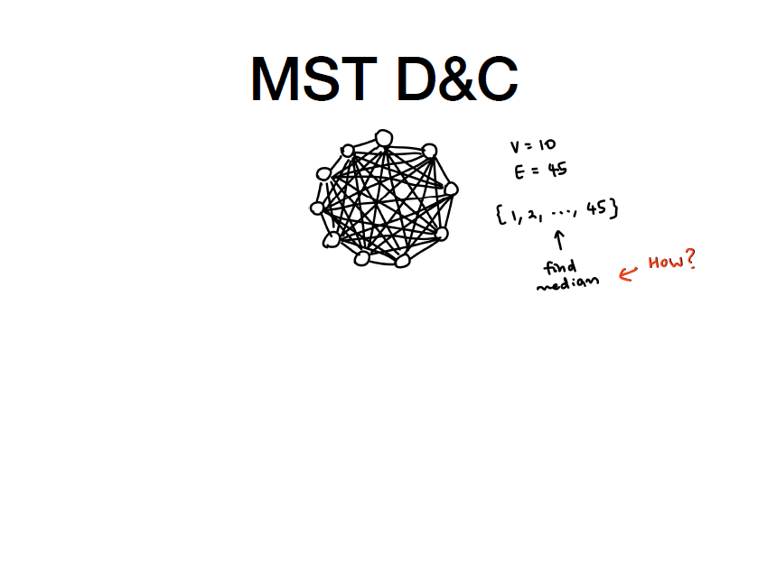
Taken from Yue Jun’s slides, with permission

Slide 54
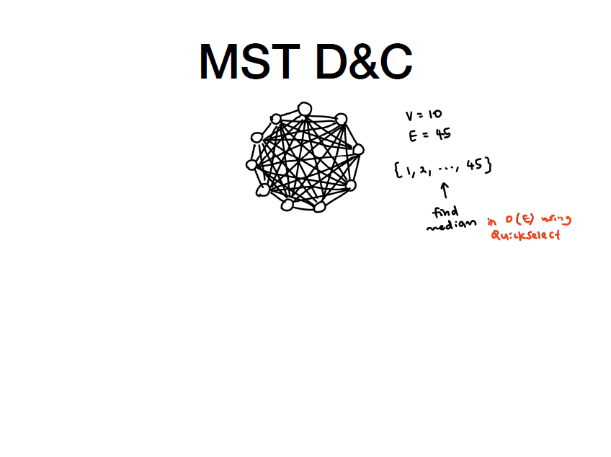
Taken from Yue Jun’s slides, with permission

Slide 55
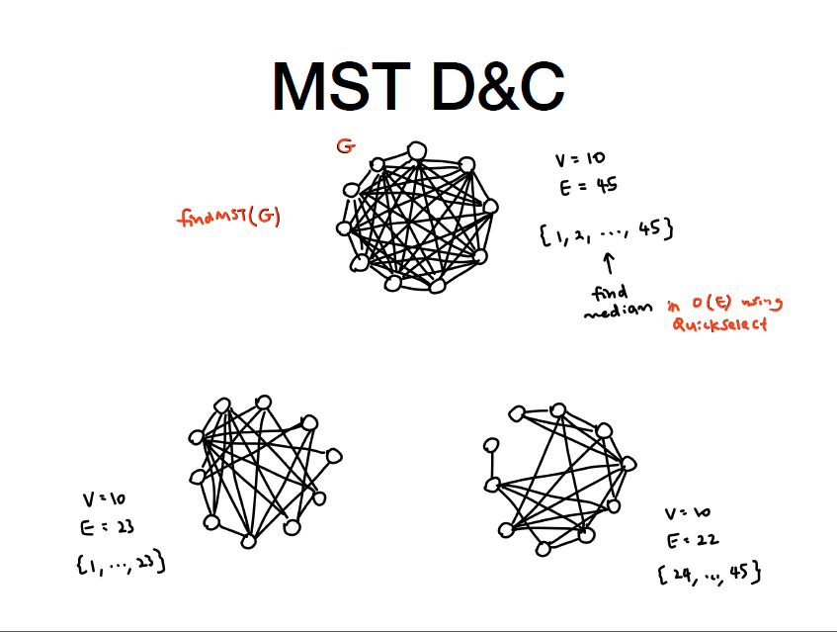
Taken from Yue Jun’s slides, with permission

Slide 56
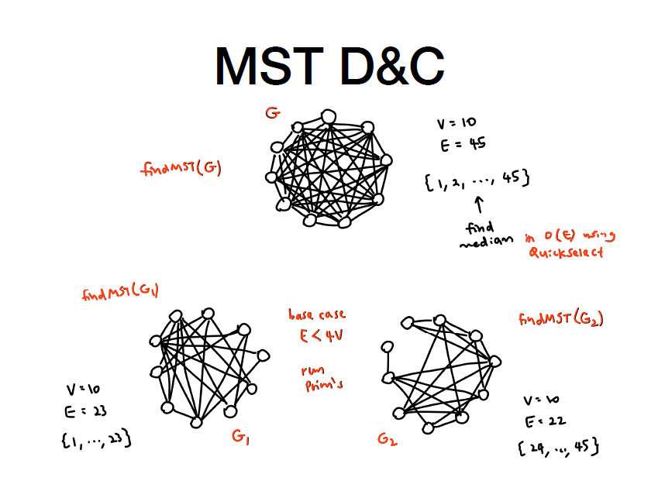
Taken from Yue Jun’s slides, with permission

Slide 57
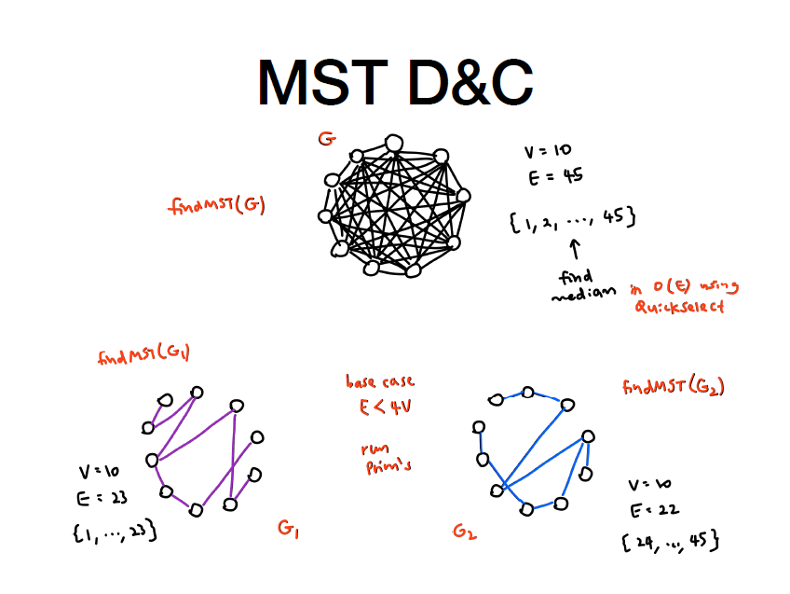
Taken from Yue Jun’s slides, with permission

Slide 58
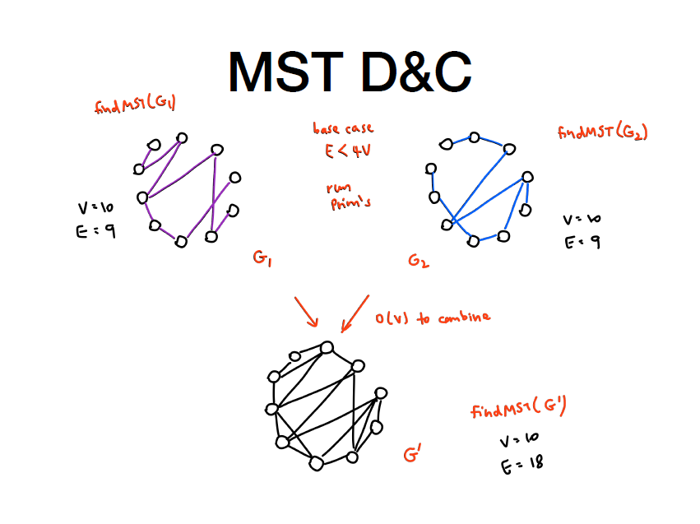
Taken from Yue Jun’s slides, with permission

Slide 59
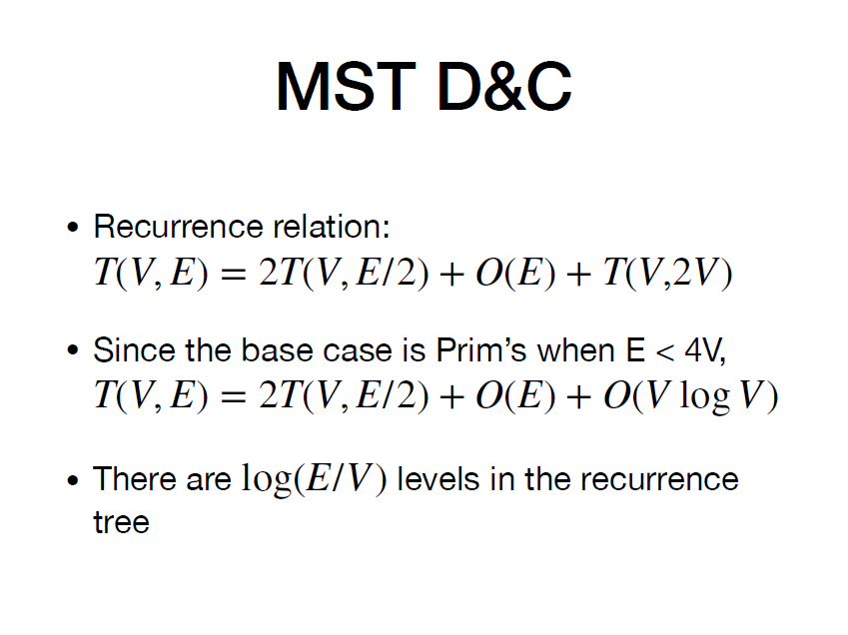
Taken from Yue Jun’s slides, with permission

Slide 60
Taken from Yue Jun’s slides, with permission

Slide 61
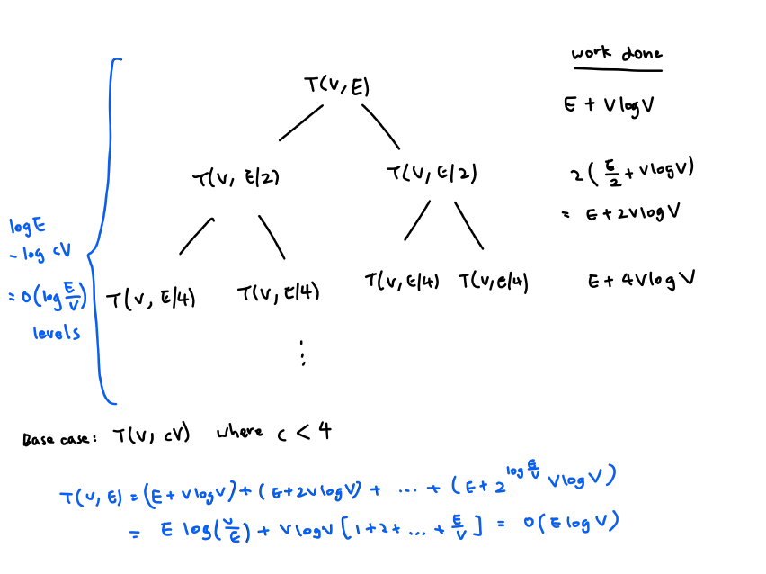
Taken from Yue Jun’s slides, with permission

Slide 62
Taken from Yue Jun’s slides, with permission

Slide 63
Q2 Divide-and-Conquer MST
Why do you think this algorithm will return a valid MST (unlike the one we saw in lecture)?

Slide 64
Q2 Divide-and-Conquer MST
When you find the recursive MST on a subset of the edges E’, every edge eliminated is a ”red edge”, i.e. an edge that is the heaviest edge on a cycle among the edges in E′; therefore it is clearly also the heaviest edge on a cycle among all the edges in E (because E′ is a subset of E).
So it is safe to eliminate edges from the MST when looking only at a subset of edges.
a strategy like this helps you build cache efficient MST algorithms

Slide 65
Q3 Road Trip

Slide 66
Q3: DP Recap :P
Optimal sub-structure: An optimal solution to a problem contains optimal solutions to its subproblems
Key understanding behind greedy algorithms as well
Overlapping sub-problems: same smaller problem can be used to solve multiple different bigger problems
example: fibonacci
If you can memoise and do it faster it might be using this property
For DP problems, you need both conditions

Slide 67
Q3: DP Recap :P
Top down vs Bottom up? Is there a difference?
Not really. Just different ways of visualising/thinking about it.
Bottom up: solve all smaller problems, combine to solve any big problem
Called Tabulation form as well
Top down: Recurse down from the biggest problem, solving the smaller problems and memoising as you go.
Remember CS1101s?

Slide 68
Q3 Road Trip
You are going on a road trip.
The tank of your car has a capacity of L litres. You begin your trip at home with a full tank of petrol. Your car uses exactly 1 liter per kilometer.
Along the way, you must ensure that your car always has petrol. When you arrive at a station s, you can choose to buy any amount of petrol, as long as it’s within the capacity of your tank. Or you can choose not to buy any petrol.
Determine how much petrol to buy at each station along the way so as to minimise the cost of your trip.

Slide 69
Q3 Road Trip
Your tank holds 6 litres, and there are 3 stations:
The best solution cost $1, where you purchase one liter of petrol at the first station (station at 5km).
Home
5km
$1
6km
$2
7km
$4

Slide 70
Q3 Road Trip
Your tank holds 20 liters, and there are 10 stations:
The best solution cost $327.
Home
7km
$3
17km
$5
20km
$2
23km
$1
39km
$5
48km
$4
66km
$9
83km
$9
88m
$4
92km
$1
Remaining Petrol | 20 | 13 | 3 | 0 | 0 | 4 | 0 | 2 | 0 | 0 | 0
Liters Purchased |  |  |  | 3 | 20 | 5 | 20 | 15 | 5 | 4

Slide 71
Q3 Road Trip
To solve this problem, we need to calculate DP(s_{j}, k), which is the minimum cost from station s_{j} to the destination, assuming you have k liters of petrol left.

Slide 72
Q3 Road Trip
To solve this problem, we need to calculate DP(s_{j}, k), which is the minimum cost from station s_{j} to the destination, assuming you have k liters of petrol left.
Suppose that we have n stations, and we have calculated DP(s_{n}, k) for all k (i.e. we know the values of DP(s_{n}, 0), DP(s_{n}, 1), … , DP(s_{n}, k), … , DP(s_{n}, L))
How to get DP(s_{n-1}, 0)?

Slide 73
Q3 Road Trip
To solve this problem, we need to calculate DP(s_{j}, k), which is the minimum cost from station s_{j} to the destination, assuming you have k liters of petrol left.
Suppose that we have n stations, and we have calculated DP(s_{n}, k) for all k (i.e. we know the values of DP(s_{n}, 0), DP(s_{n}, 1), … , DP(s_{n}, k), … , DP(s_{n}, L))
How to get DP(s_{n-1}, 0)?
Firstly, we need enough petrol to get from s_{n-1} to s_{n}. Denote h = d(s_{n}) - d(s_{n-1}).

Slide 74
Q3 Road Trip
To solve this problem, we need to calculate DP(s_{j}, k), which is the minimum cost from station s_{j} to the destination, assuming you have k liters of petrol left.
Suppose that we have n stations, and we have calculated DP(s_{n}, k) for all k (i.e. we know the values of DP(s_{n}, 0), DP(s_{n}, 1), … , DP(s_{n}, k), … , DP(s_{n}, L))
How to get DP(s_{n-1}, 0)?
Firstly, we need enough petrol to get from s_{n-1} to s_{n}. Denote h = d(s_{n}) - d(s_{n-1}).
We can choose to buy h, h + 1, … , L liters of petrol.
Minimum amount of petrol to get to s_{n}

Slide 75

Q3 Road Trip
To solve this problem, we need to calculate DP(s_{j}, k), which is the minimum cost from station s_{j} to the destination, assuming you have k liters of petrol left.
Suppose that we have n stations, and we have calculated DP(s_{n}, k) for all k (i.e. we know the values of DP(s_{n}, 0), DP(s_{n}, 1), … , DP(s_{n}, k), … , DP(s_{n}, L))
How to get DP(s_{n-1}, 0)?
Firstly, we need enough petrol to get from s_{n-1} to s_{n}. Denote h = d(s_{n}) - d(s_{n-1}).
We can choose to buy h, h + 1, … , L liters of petrol.
Hence, DP(s_{n-1}, 0) =
Buy i liters of petrol
Use h liters of petrol to get from s_{n-1} to s_{n}

Slide 76
Q3 Road Trip
To solve this problem, we need to calculate DP(s_{j}, k), which is the minimum cost from station s_{j} to the destination, assuming you have k liters of petrol left.
How to get DP(s_{n-1}, 1)?

Slide 77
Q3 Road Trip
To solve this problem, we need to calculate DP(s_{j}, k), which is the minimum cost from station s_{j} to the destination, assuming you have k liters of petrol left.
How to get DP(s_{n-1}, 1)?
We still need h liters of petrol to get from s_{n-1} to s_{n}. But now, we are starting with 1 liter of petrol.

Slide 78
Q3 Road Trip
To solve this problem, we need to calculate DP(s_{j}, k), which is the minimum cost from station s_{j} to the destination, assuming you have k liters of petrol left.
How to get DP(s_{n-1}, 1)?
We still need h liters of petrol to get from s_{n-1} to s_{n}. But now, we are starting with 1 liter of petrol.
Hence, we can purchase h - 1, h, …, L - 1 liters of petrol.
We only need to purchase at least h - 1 liters since we are starting with 1 liter of petrol.
The max capacity of the tank is L liters, hence we can only purchase at most L - 1 liters.

Slide 79
Q3 Road Trip
To solve this problem, we need to calculate DP(s_{j}, k), which is the minimum cost from station s_{j} to the destination, assuming you have k liters of petrol left.
How to get DP(s_{n-1}, 1)?
We still need h liters of petrol to get from s_{n-1} to s_{n}. But now, we are starting with 1 liter of petrol.
Hence, we can purchase h - 1, h, …, L - 1 liters of petrol.
DP(s_{n-1}, 1) =
start with 1 liter of petrol
Use h liters of petrol to get from s_{n-1} to s_{n}.
Buy i liters of petrol

Slide 80
Q3 Road Trip
To solve this problem, we need to calculate DP(s_{j}, k), which is the minimum cost from station s_{j} to the destination, assuming you have k liters of petrol left.
How to get DP(s_{n-1}, k)?

Slide 81
Q3 Road Trip
To solve this problem, we need to calculate DP(s_{j}, k), which is the minimum cost from station s_{j} to the destination, assuming you have k liters of petrol left.
How to get DP(s_{n-1}, k)?
We can purchase max(0, h - k), …, L - k liters of petrol.
If h < k, h - k < 0.
But we cannot purchase negative liters of petrol. Thus, we need to take the max(h - k, 0).
The max capacity of tank is L liters. Hence, we can only buy at most L - k liters of petrol.

Slide 82
Q3 Road Trip
To solve this problem, we need to calculate DP(s_{j}, k), which is the minimum cost from station s_{j} to the destination, assuming you have k liters of petrol left.
How to get DP(s_{n-1}, k)?
We can purchase max(0, h - k), …, L - k liters of petrol.
Hence, DP(s_{n-1}, k) =
To get DP(s₀, L), we can run DP backwards from s_{n} to s₀.

Slide 83
Q3 Road Trip
Runtime Analysis:
Runtime to get one DP(s_{i}, k): O(L)
Runtime to get DP(s_{i}, k) for all 0 ≤ k ≤ L: O(L²)
Runtime to get DP(s_{i}, k) for all 0 ≤ i ≤ n, 0 ≤ k ≤ L: O(nL²)

Slide 84
Q3 Road Trip
Alternatively, we can do the DP in a bottom-up manner.
Define DP’(sj, k) to be the minimum cost to get from home to station sj.
To reach s_{j} with k liters remaining, you can decide to either go from s_{j-1} with k + h liters or pump 1 liter of petrol at s_{j} with k - 1 liters remaining.

Slide 85
Q3 Road Trip
Alternatively, we can do the DP in a bottom-up manner.
Define DP’(sj, k) to be the minimum cost to get from home to station sj.
To reach s_{j} with k liters remaining, you can decide to either go from s_{j-1} with k + h liters or pump 1 liter of petrol at s_{j} with k - 1 liters remaining.
Runtime: O(nL)

Slide 86
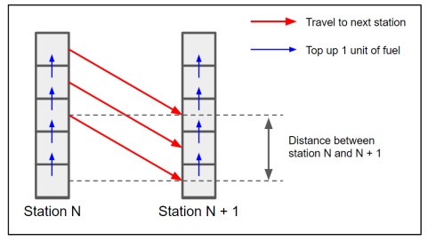
Q3 Road Trip
Runtime: O(nL)

Slide 87
3
Alternative greedy solution (much much faster):
Use the following logic at each station:
If there exists a station < L away that sells cheaper petrol, buy just enough petrol to get to that station (if needed)
Else, if the end station is < L away, buy just enough petrol to reach the end station (if needed)
Else, buy as much petrol as you can
Notes:
i haven’t thought through this slide yet

Slide 88
Dynamic Programming: tips + strategy
do not unroll the recursion
The subproblems overlap, and unrolling the recursion does not show the overlapping subproblem. You will not get the optimal answer
Find the relation between the subproblems
What order can you fill in the table in?
Time complexity
Should be easy to find the lower-bound: number of subproblems you have
Additional time complexity → from processing the table. Possible when you need to update the values after you compute other values.
Space complexity: size of the table

Slide 89
Q4 Power Plant

Slide 90
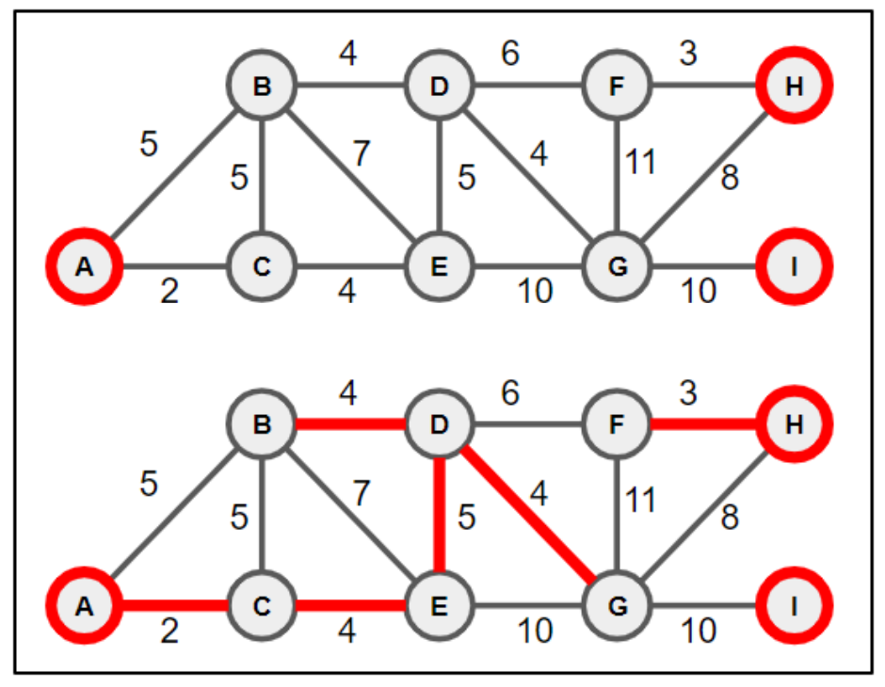
Q4 Power Plant
Red nodes: power plants
How do you find the minimum cost where each node is connected to a power plant?
(Assume there is a solution)

Slide 91
Q4 Can you just run a MST algorithm?
Prim’s? Kruskal’s?

Slide 92
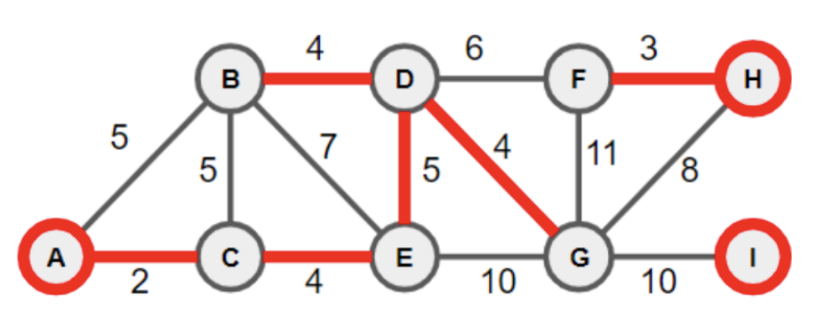
Q4 Can you just run a MST algorithm?
No! If you look at the solution, it isn’t 1 connected component. If it’s alr attached to a power node there’s no need to include that extra edge.
Can you make any observations about the given solution?

Slide 93
Q4 Observation
There are as many MSTs as there are power nodes

Slide 94
Q4 Observation
There are as many MSTs as there are power nodes
Intuition: “run MST algo from all the power nodes simultaneously”
a multi-source MST algorithm

Slide 95
Q4 Using Prims
Start off with all the power plant nodes in the PriorityQueue and run Prim’s algorithm.
So every node discovered later can be traced back to exactly one of the power plant nodes
note that this slide is adapted from Christian’s also

Slide 96
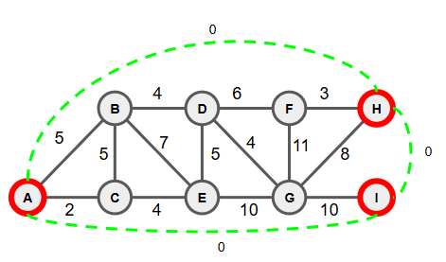
Q4 Using Kruskal’s
Build on the intuition that houses are connected to one power plant: We want to make sure that once a house is connected to a power plant, it should not connect to any other power plant
Connect all the power plants with 0-weighted edges.
This starts all the power plants in the same connected component.
note that this slide is adapted from Christian’s also

Slide 97
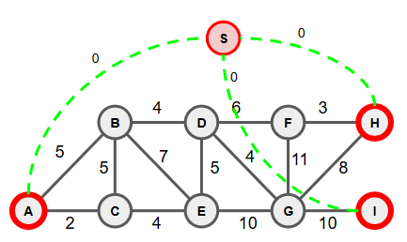
Q4: Alternate graph transformation
Create a supernode that is connected to each of the power plant with edge weight 0
Run any MST from the super node
Works bc all powerplant nodes will be in the same connected component with 0 cost.

Slide 98
Traffic Reduction

Slide 99
Q5: Traffic Reduction
In order to reduce traffics, the Singapore government has passed a new law - cars are not allowed to go in circles. If you drive around in a circle, you will be charged a fine. Your job is to deploy a set of cameras to monitor the roads and catch drivers that are violating the new law.
For this problem, you are given a road map of Singapore as a connected, undirected graph G = (V, E). For each road (i.e., edge) e, you are given the cost w(e) of building a camera station that can detect when the same car passes twice. Your job is to find a minimal set of roads (i.e., edges) such that you can detect any car that makes a circle.

Slide 100
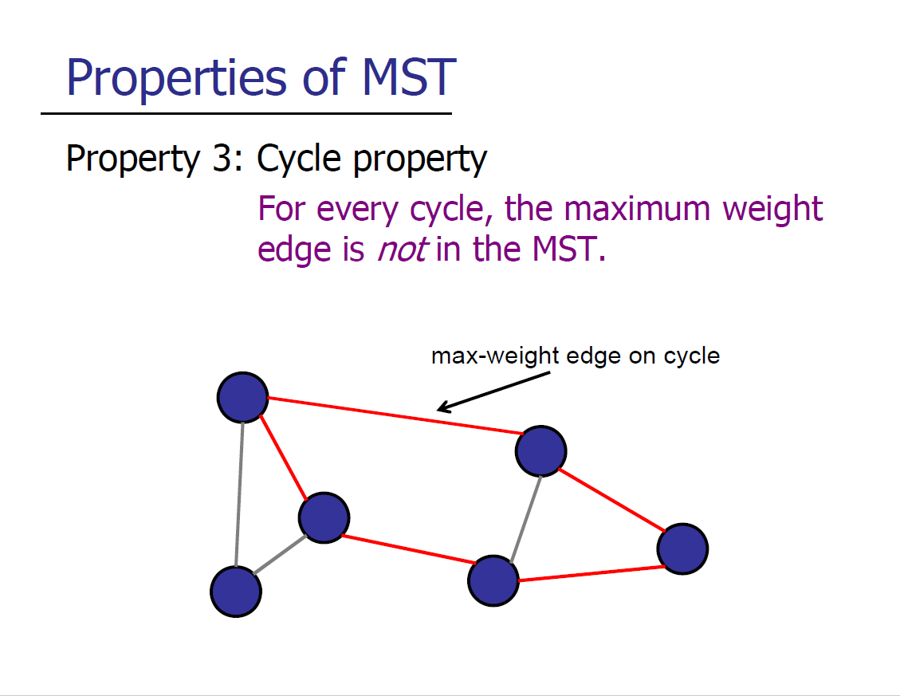
Q5: Traffic Reduction
Goal: Find edges that cover all cycles
(and have this be the lowest cost)

Slide 101
Q5: Traffic Reduction
Goal: Find edges that cover all cycles
(and have this be the lowest cost)
MST algorithms find edges to connect everything with no cycles, minimising the weight of these edges so that the maximum weight edge is the one not in the MST

Slide 102
Q5: Traffic Reduction
Key idea: Use the reverse of a minimal spanning tree to exclude the minimum weight edge from every cycle, and put a camera on all these minimum weight edges
We can call this spanning tree with all the biggest edges a maximal spanning tree (MaxSt)

Slide 103
Q5: Traffic Reduction
Key idea: Use the reverse of a minimal spanning tree to exclude the minimum weight edge from every cycle, and put a camera on all these minimum weight edges
Negate all edges (to find maximum instead of minimum)
Use MST algorithm to find a spanning tree (Maximal Spanning Tree, MaxST)
All non-MaxST edges will be the cheapest set of edges to catch anyone driving around in a circle

Slide 104
Q6 (just for fun)

Slide 105
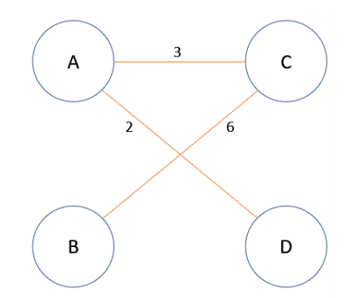
Q6 (just for fun)
Similar to problem 5 (ensuring certain edges are selected)
Goal is to maximise the total weight of all black edges in the MST, which you get to add (and you win ties). You can add any number of edges

Slide 106
Q6 (just for fun)
Similar to problem 5 (ensuring certain edges are selected)
Goal is to maximise the total weight of all black edges in the MST, which you get to add (and you win ties). You can add any number of edges
Consider the cut property again: maximum edge in the cycle is excluded. Try to make your black edges be the ones included.

Slide 107
Q6 (just for fun)
For each edge you can add, consider possible cuts (where MST would be the smallest in that cut). Consider adding edge AB
3
3
A
C
A
C
6
6
2
2
B
D
B
D
max weight to be selected in MST = 5
→ choose this
max weight to be selected = 1

Slide 108
Q6 (just for fun)
For each edge you can add, consider possible cuts (where MST would be the smallest in that cut).
Add the biggest possible edge that would be selected in a cut (1 less than the smallest across a cut)
Repeat for CD and BD
Even if Prof plays optimally, you will always win (because you win ties)

Slide 109
Q7: Espionage

Slide 110
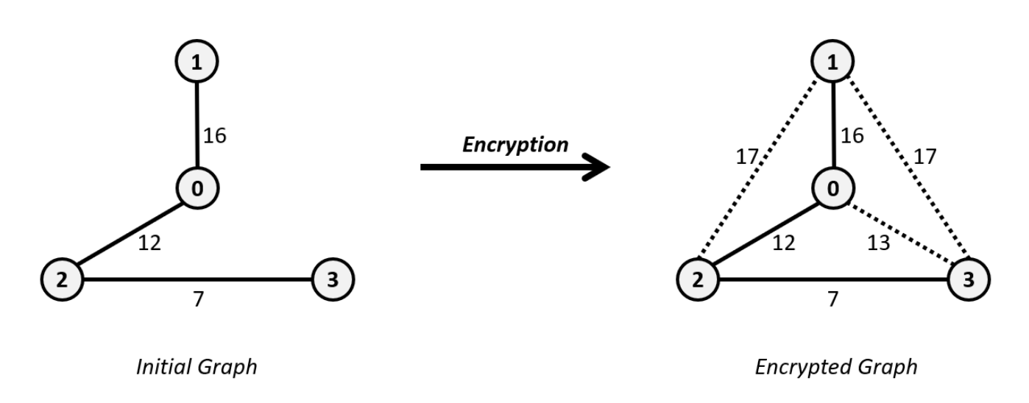
Q7: Summary of Question
You are a spy who wants to encrypt a tree of nodes by transforming it into a complete graph.
The original message must be the unique minimum spanning tree of the complete graph
You want to minimise the cost of edges you add in to transform it into a complete graph
Output: the total cost of the edges you must add

Slide 111
Q7: Approach
How do you force an MST algorithm to select certain edges?
Let’s use the example of Kruskal’s algorithm
Kruskal selects the edge that is smallest and avoids cycles

Slide 112
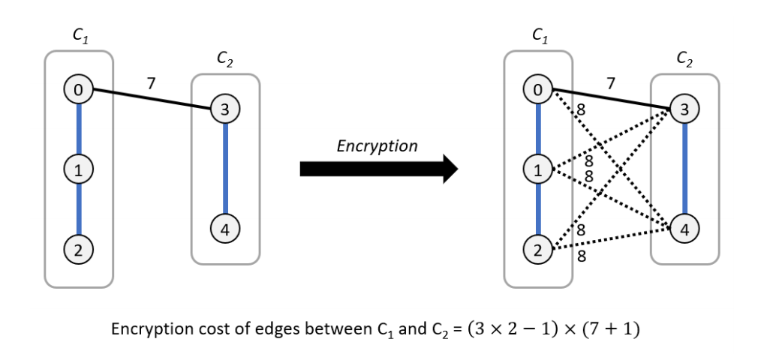
Q7: Approach
How do you force an MST algorithm to select certain edges?
Let’s use the example of Kruskal’s algorithm
Kruskal selects the edge that is smallest and avoids cycles
All added edges hence must be the largest edge in the cycle

Slide 113
Q7: Note
When connecting these two disjoint components, none of the new edges can have a weight less than the original edge connecting the components
If it is the same weight, there is no guarantee which is processed first.
A
7
D
both AD or CE might be added to the tree, so the MST is no longer unique
B
E
C
7
C₂
C₁

Slide 114
Q7: Approach
How many edges do you insert?

Slide 115
Q7: Approach
How many edges do you insert?
S1 x S2 - 1 (1 being the original edge in the tree)
(in the below example, 3*2 -1 = 5 edges)
Added cost: (7+1) * 5 edges = 30

Slide 116
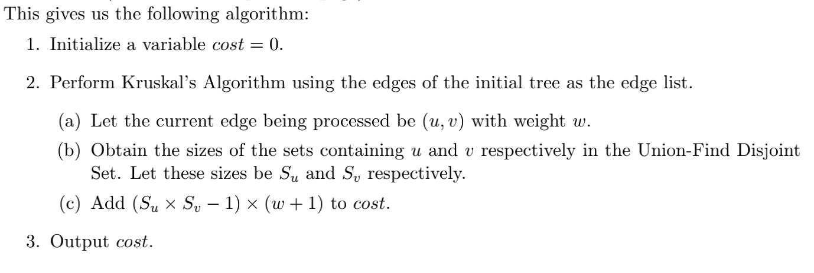
Q7: Solution

Slide 117
Q7: Solution Time Complexity

Slide 118
Q7: Solution Time Complexity
Same as Kruskal O(ElogV) as we only do additional constant work for the math.
But since we started with E = N - 1, and V = N (A tree) → O(NlogN)

Slide 119

Another example
Espionage
Let’s try to derive back this MST to the complete graph
A
A
10
B
D
B
D
3
15
7
C
E
C
E
slides from Christian

Slide 120
Another example
Espionage
Pick 3, but we don’t need to add additional edges
A
A
10
B
D
B
D
3
3
15
7
C
E
C
E
slides from Christian

Slide 121
Another example
Espionage
Pick 7
A
A
10
B
D
B
D
3
3
15
7
7
C
E
C
E
slides from Christian

Slide 122
Another example
Espionage
Gotta add an edge of weight 8
A
A
10
B
D
B
D
3
3
15
7
7
C
E
C
E
8
slides from Christian

Slide 123
Another example
Espionage
Pick 10. Both A and B are lonely connected components so don’t need to add more edges!
A
A
10
10
B
D
B
D
3
3
15
7
7
C
E
C
E
8
slides from Christian

Slide 124
Another example
Espionage
Finally pick 15!
A
A
10
10
B
D
B
D
3
3
15
7
15
7
C
E
C
E
8
slides from Christian

Slide 125
Another example
Espionage
And add all the green edges with weight 16
A
A
10
10
B
D
B
D
3
3
15
7
15
7
C
E
C
E
8
slides from Christian

Slide 126
Appendix

Slide 127
Boruvka’s Algorithm
(slides from Christian
not tested this year)

Slide 128
Boruvka’s Algorithm
Basic Idea: “Add obvious edges, rinse & repeat”
3
E
A
5
4
2
2
C
F
4
3
3
3
2
B
D
G

Slide 129
Boruvka’s Algorithm
Basic Idea: “Add obvious edges, rinse & repeat”
Start with V connected components
3
E
A
5
4
2
2
C
F
4
3
3
3
2
B
D
G

Slide 130
Boruvka’s Algorithm
Basic Idea: “Add obvious edges, rinse & repeat”
Start with V connected components
Go through all connected components and add minimum outgoing edges
3
E
A
5
4
2
2
C
F
4
3
3
3
2
B
D
G

Slide 131
3
E
A
5
Boruvka
4
2
Start with A
2
C
F
4
3
3
3
2
B
D
G

Slide 132
3
E
A
5
Boruvka
4
2
Lightest edge is 2
2
C
F
4
3
3
3
2
B
D
G

Slide 133
3
E
A
5
Boruvka
4
2
Followed by B, which has the same lightest edge (this doesn’t matter!)
2
C
F
4
3
3
3
2
B
D
G

Slide 134
3
E
A
5
Boruvka
4
2
Then C, with 2 as its lightest edge
2
C
F
4
3
3
3
2
B
D
G

Slide 135
3
E
A
5
Boruvka
4
2
Then D, with 2 as its lightest edge
2
C
F
4
3
3
3
2
B
D
G

Slide 136
3
E
A
5
Boruvka
4
2
E, with 2 (that has been added as its lightest edge)
2
C
F
4
3
3
3
2
B
D
G

Slide 137
3
E
A
5
Boruvka
4
2
F, with 3 as its lightest edge
2
C
F
4
3
3
3
2
B
D
G

Slide 138
3
E
A
5
Boruvka
4
2
Finally G, with 2 as its lightest edge (which also has been added)
2
C
F
4
3
3
3
2
B
D
G

Slide 139
Boruvka’s Algorithm
Basic Idea: “Add obvious edges, rinse & repeat”
Start with V connected components
Go through all connected components and add minimum outgoing edges
3
E
A
5
4
2
2
C
F
4
3
3
3
2
B
D
G

Slide 140
Boruvka’s Algorithm
Basic Idea: “Add obvious edges, rinse & repeat”
Start with V connected components
Go through all connected components and add minimum outgoing edges
Repeat for the remaining connected components!
3
E
A
5
4
2
2
C
F
4
3
3
3
2
B
D
G

Slide 141
Boruvka’s Algorithm
Basic Idea: “Add obvious edges, rinse & repeat”
Start with V connected components
Go through all connected components and add minimum outgoing edges
Repeat for the remaining connected components!
And we get the MST!
3
3
E
E
A
A
2
2
F
C
F
2
C
2
3
3
3
3
2
B
2
B
D
D
G
G

Slide 142
Boruvka step
Note: We label every node with a component identifier to show they are in the same connected component
A “Boruvka step”: O(V + E)
For each of the connected components, perform BFS/DFS to search for the minimum weight outgoing edge to the other component. O(V + E)
Add selected edges to the MST
Merge connected components together (by re-computing component ids). O(V)

Slide 143
Time Complexity Analysis
If we start off with k connected components, doing one “Boruvka step” will:
Add at least k / 2 edges
At least k / 2 components merge
At most k / 2 components remain

Slide 144
Time Complexity Analysis
Why do we know that one Boruvka step will add at least k / 2 edges?
Intuition: Some edges are “re-added” by another vertex

Slide 145
Time Complexity Analysis
Why do we know that one Boruvka step will add at least k / 2 edges?
Intuition: Some edges are “re-added” by another vertex
“Best case”:
1
2
3
4
5
6

Slide 146
Time Complexity Analysis
Why do we know that one Boruvka step will add at least k / 2 edges?
Intuition: Some edges are “re-added” by another vertex
Can solve in one boruvka
step!
1
2
3
4
5
6

Slide 147
Time Complexity Analysis
Why do we know that one Boruvka step will add at least k / 2 edges?
Intuition: Some edges are “re-added” by another vertex
“Worst case”:
1
4
2
5
3
6

Slide 148
Time Complexity Analysis
Why do we know that one Boruvka step will add at least k / 2 edges?
Intuition: Some edges are “re-added” by another vertex
Every added edge is re-added by another vertex :(
1
4
2
5
3
6

Slide 149
Time Complexity Analysis
If we start off with k connected components, doing one “Boruvka step” will:
Add at least k / 2 edges
At least k / 2 components merge
At most k / 2 components remain

Slide 150
Time Complexity Analysis
How many Boruvka steps do we need to finish the algorithm?
0 boruvka step (havent started) -> V connected components

Slide 151
Time Complexity Analysis
How many Boruvka steps do we need to finish the algorithm?
0 boruvka step (havent started) -> V connected components
1 boruvka step -> At most V/2 connected components

Slide 152
Time Complexity Analysis
How many Boruvka steps do we need to finish the algorithm?
0 boruvka step (havent started) -> V connected components
1 boruvka step -> At most V/2 connected components
2 boruvka step -> At most V/4 connected components
…
logV boruvka steps -> At most 1 connected components (we got the MST!)
A boruvka step: O(V + E)
logV boruvka steps: O((V + E)logV) = O(ElogV)

